Slide 1
Data Analysis for Derby County F.C.
Edward Webster
September 2020

Slide 2
Contents
Background slides:
About this presentation pack
Task brief
Workflow and tools used for this data analysis
Datasets used
Data analysis slides:
Player demographics
Team demographics
Player Radars

Slide 3
The aim of this presentation pack:
To used data analysis as the starting point to identify replacements for two Derby County players –
Jayden Bogle and Tom Lawrence

Slide 4
Task Brief
Identify potential replacements for two Derby County players - Jayden Bogle and Tom Lawrence, using data analysis.
Suggest ~3 target replacements for each of the two players
At least one of your recommendations for each position should be a player aged 23 or younger.
Due to budgetary restrictions, you should also recommend at least one player from a division lower than the Championship.
Important considerations when providing recommendations:
The attainability of any potential targets given the club's budget and standing;
Whether a potential recruit may be undervalued;
Whether a potential recruit would fit with Derby's playing style;
How far you expect a young player's performances to improve as they gain experience;
How a player's performance might translate from League One or League Two up to the Championship.

Slide 5


Workflow and Tools
Programming languages and visualisation tools used in this sample project
For the data preparation (backend), the data has been acquired (scraped) using Python and then engineered using Python in a Jupyter notebooks environment.
The frontend tools created from the data are built using Tableau. The reason why I chose to use Tableau to visualise the data is due to the products functionality and ease-of-use to those at all levels of the football club, including coaching staff and players. Tableau dashboards can be published and accessed on iPads and mobile devices, enabling use by the coaches and players on the training field, the changing room, or at home. For data analysis to be effective, it needs to be a part of the holistic approach of the club and be accessible not just to power users such as Data Analysts and Data Scientists, but to everyone at every level of the club. In my opinion, Tableau is the best tool for this.
If Tableau is not available as a product to the club, the data can be visualised using PowerBI or a number of Python packages including matplotlib, Seaborn, or Plotly, to name but a few (examples of different visualisation projects are available in my GitHub repo).

Slide 6
Workflow Flow Chart
Data Acquisition and Parsing
Data Engineering
Data from TransferMarkt is scraped using Python webscrapers.
Data Visualisation and Analysis
Scraped data from TransferMarkt is cleaned and engineered using the pandas Python library in Jupyter notebooks.
Data visualised in the Jupyter notebooks, as dashboards using Tableau, and as figures in PowerPoint slides.
Dashboards published to Tableau Public.
Fuzzy data matching of the two data sources from 21st Club and TransferMarkt enables creation of new analysis of Stats per £ metrics.
Key observations and comments of the data analysis includes in PowerPoint figures.
Data from 21st Club is provided in the email as a CSV file.
Data from 21st Club is engineered to create new KPIs and attributes derived from the raw data to create tailor-made metrics for the coaches and data teams. The DataFrame is also melted as a long table to create radar visualisations.

Slide 7
Metric used in Analysis
Different metrics selected for the each player’s varying position
Depending on the position, different metrics are required to assess a player performance. These metrics are explain for full-backs and wingers in detail in the following two slides.
Metrics that might be deemed a good measure of performance for an attacking player, such as goals and assists, may not be as suited for defensive players that contribute in others was such as tackles and aerial duels.
Metrics are also required to be standardised so that players that have played a full season can be compared to those that maybe joined in January, player that are/have been injured, or young player who drift in and out of the squad, to name but a few examples. For this, a per 90 metric was created, to standardised numbers per time played.
The metrics provided in the dataset have also been used to derive new, aggregated metrics. Examples of this includes the Deep Progressions metric, which is a summation of a player’s passes, dribbles, and carries into the box. Depending on the player type, he may be a crosser such as David Beckham, or a dribbler such as Lionel Messi, or an incisive passer such as David Silva, to name but a few broad examples. These metrics hope to provide a way to compare players that all may be effective, but in different ways.
Full list of all metrics from the original data source can be found in the appendix.

Slide 8
Full-Back Metrics
Metrics chosen to best analyse a full-back’s abilities
Tackles p90 = Tackles per 90 minutes (where p90 is a calculated field of Play Time / 90)
Interceptions p90 = Interceptions per 90 minutes
Recoveries p90 = Recoveries per 90 minutes
Deep Progressions p90 = (Pass Op Box + Dribbles Box + Carries Box) per 90 minutes
Blocks p90 = Blocks per 90 minutes
Carries p90 = Carries per 90 minutes
Passing OP % = (Pass OP Box Successful + Pass OP Final Third Successful + Pass OP Head Successful) ÷ (Pass OP Box + Pass OP Final Third + Pass OP Head)
Dribbles % = Dribbles Successful ÷ Dribbles
Launches % = Launches Successful / Launches
Aerial Duels % = (Aerial Duels Att Won + Aerial Duels Def Won) ÷ (Aerial Duels Att + Aerial Duels Def)
Ground Duels % = (Ground Duels Att Won + Ground Duels Def Won) ÷ (Ground Duels Att + Ground Duels Def)
Crosses OP % = Crosses OP Successful ÷ (Crosses OP Left + Crosses OP Right)
Full list of all metrics from the original data source can be found in the appendix.

Slide 9
Winger Metrics
Metrics chosen to best analyse a winger’s abilities
Shots per Goal = Shots + Goals
Goals p90 = Goals per 90 minutes (where p90 is a calculated field of Play Time / 90)
Shots p90 = Shots per 90 minutes
Assists p90 = (Pass Op Box + Dribbles Box + Carries Box) per 90 minutes
Interceptions p90 = Interceptions per 90 minutes
Deep Progressions p90 = (Pass Op Box + Dribbles Box + Carries Box) per 90 minutes
Carry Distance p90 = Carry Distance per 90 minutes
Carries Box p90 = Carries in the Box per 90 minutes
Dribbles % = Dribbles Successful ÷ Dribbles
Crosses OP % = Crosses OP Successful ÷ (Crosses OP Left + Crosses OP Right)
Passing OP % = (Pass OP Box Successful + Pass OP Final Third Successful + Pass OP Head Successful) ÷ (Pass OP Box + Pass OP Final Third + Pass OP Head)
Passing OP Box % = Pass OP Box Successful ÷ Pass OP Box
Full list of all metrics from the original data source can be found in the appendix.

Slide 10
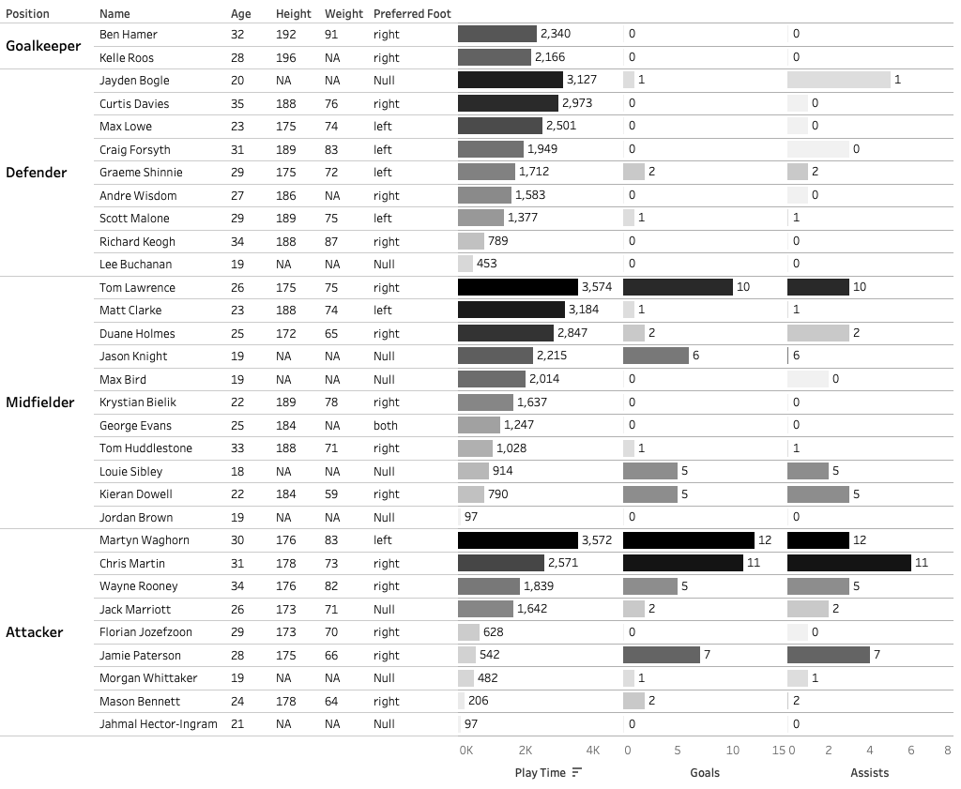
Tool 1: Player Demographics
Simple bar charts the deliver key player information quickly and concisely
Simple bar chart that splits players into their positions – goalkeeper, defender, midfielder, and forward.
The bars show for each player the minutes played, no. appearances, no. starts, and the estimated transfer value.
In this example, we can see the players that had the most minutes on the pitch for Liverpool during their title-winning season.
Dataset is created by fuzzy matching two independent datasets - player performance data from FBref, provided by Statsbomb, and player valuation data from TransferMarkt,
Dataset covers all players in the Big 5 European leagues for the 17/18-20/21 seasons.
Data can be filtered for league, season, club, player nationality, a player’s estimated market value, age, or number of games played by the player.
This is a nice and simple dashboard that can provide a lot of key player information to the analysts and coaches in seconds, all in one location.
Ideas of data that would be good to potentially include:
No. substitute appearances (on and off)
Player height
Dominant foot
Player performance data provided by FBref and estimated market value data provided by TransferMarkt

Slide 11
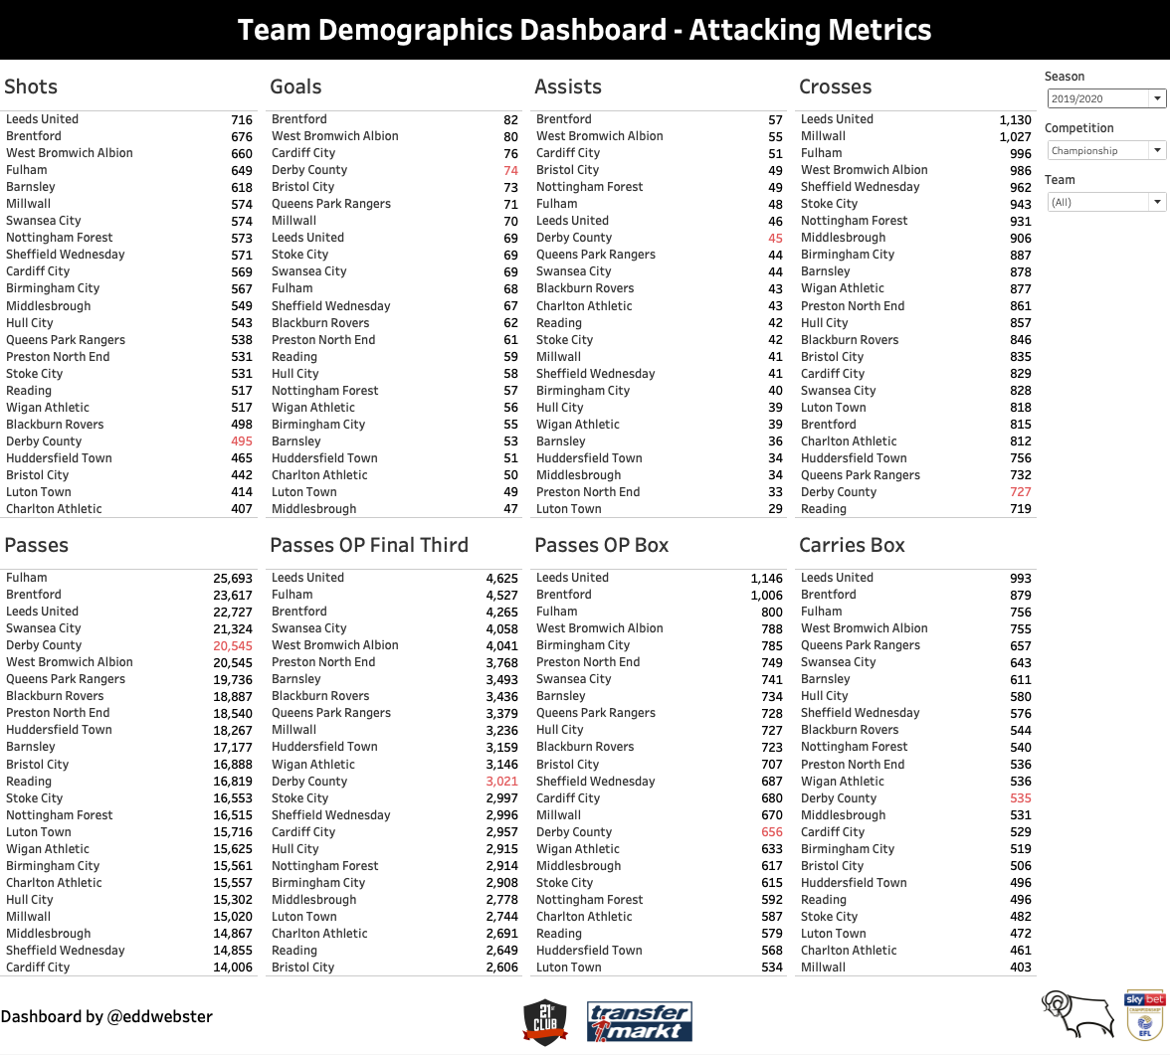
Tool 2: Team Demographics Dashboard
Interactive visualisation of per positions metrics
A dashboard of simple bar charts that show the key metrics of teams.
The metrics have been split across two dashboards – attack and defensive metrics.
Dashboards can be filtered by:
Season
Competition
Team
The idea of this dashboard is to quickly gauge an idea of a team’s playing style and the aspects of the game in which they excel/do less well compared to other teams.
In this attacking metrics table, we can suggest that Derby County are a possession-based (5th/24 for passes) and a high scoring team (4th) for who take relative few shots (20th). This suggests they are efficient at taking their chances. They are averagely ranked for Open Play Passes into the Final Third and Box, and Carries into the Box, and cross the ball very little (23rd for crosses), which suggests that their build-up play is very patient and they prefer to have players who are happy to have the ball.
Selecting a team in one of the metrics highlights that same team in the other metrics.
Metrics that could be used to improve the performance of this radar with additional Event data:
‘Expected’ metrics: Expected Goals (xG), Expected Assists (xA), xGBuildup, and Expected Threat (xT),
Team possession
Player performance data provided by 21st Club and estimated market value data provided by TransferMarkt

Slide 12
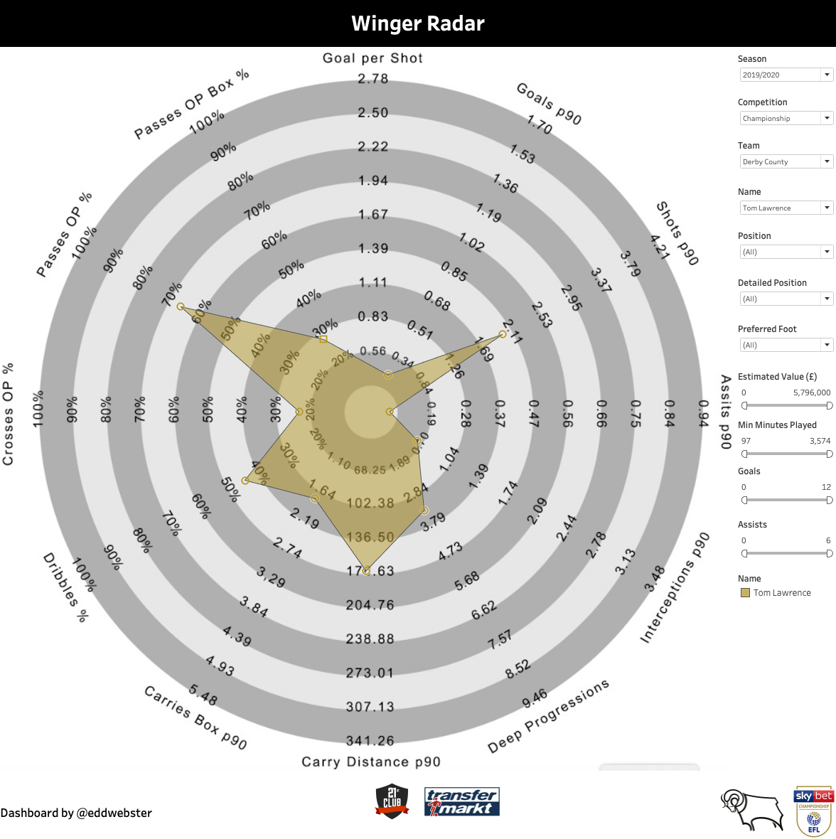
Tool 3: Radar Dashboard
Interactive visualisation of per positions metrics
Interactive player radars created using the player performance provided by 21st Club.
Data can be filtered by:
Season
Competition
Estimated Player Value
Preferred Foot
Age
Minutes Played
Goals Scored
Bespoke radars created per position to assess the metrics of most important KPIs to different team roles.
Metrics calibrated per 90 minutes to standardised so that players that have played a full season can be compared to those that maybe joined in January, player that are/have been injured, or young player who drift in and out of the squad, to name but a few examples. For this, a per 90 metric was created, to standardised numbers per time played.
Metrics that could be used to improve the performance of this radar with additional Event data:
Expected Goals (xG),
Expected Assists (xA),
xGBuildup,
Expected Threat (xT),
Turnovers – how often a player loses the ball via a miscontrol or a failed dribble per 90 minutes,
Possession Adjusted (PAdj) metrics to recalibrate metrics based on a team’s possession,
Fouls,
Tackles verse Dribbles Past
Player performance data provided by 21st Club and estimated market value data provided by TransferMarkt

Slide 13
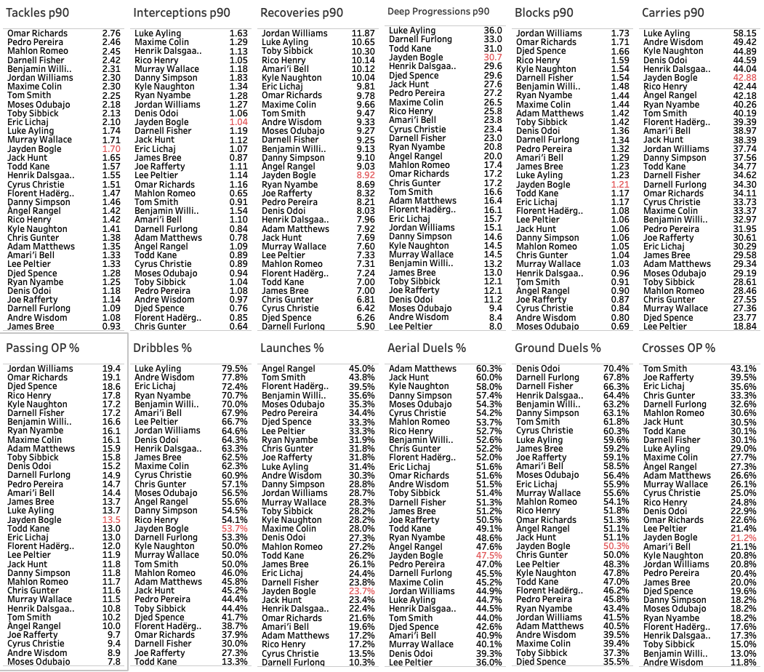
Tool 4: Ranking of Per Position Metrics
Further breakdown of the selected metrics per position to rank players
This simple attacking metrics dashboard shows the key defensive metrics of the players in the Championship 2019/20 season.
These metrics include: tackles p90, interceptions p90, recoveries p90, deep progressions p90, blocks p90, carries p90, passing OP%, dribbles %, launches %, aerial duels %, ground duels %, and crosses OP%.
This data has been filtered to show only the most recent season – 2019/20.
A player highlighted in one table is also highlighted in other tables.
…
In real world scouting, these metric would be agreed between the data analysts, the coaches, and the manager, to ensure that players are asses for the right playing style.
Team performance data provided by 21st Club.

Slide 14
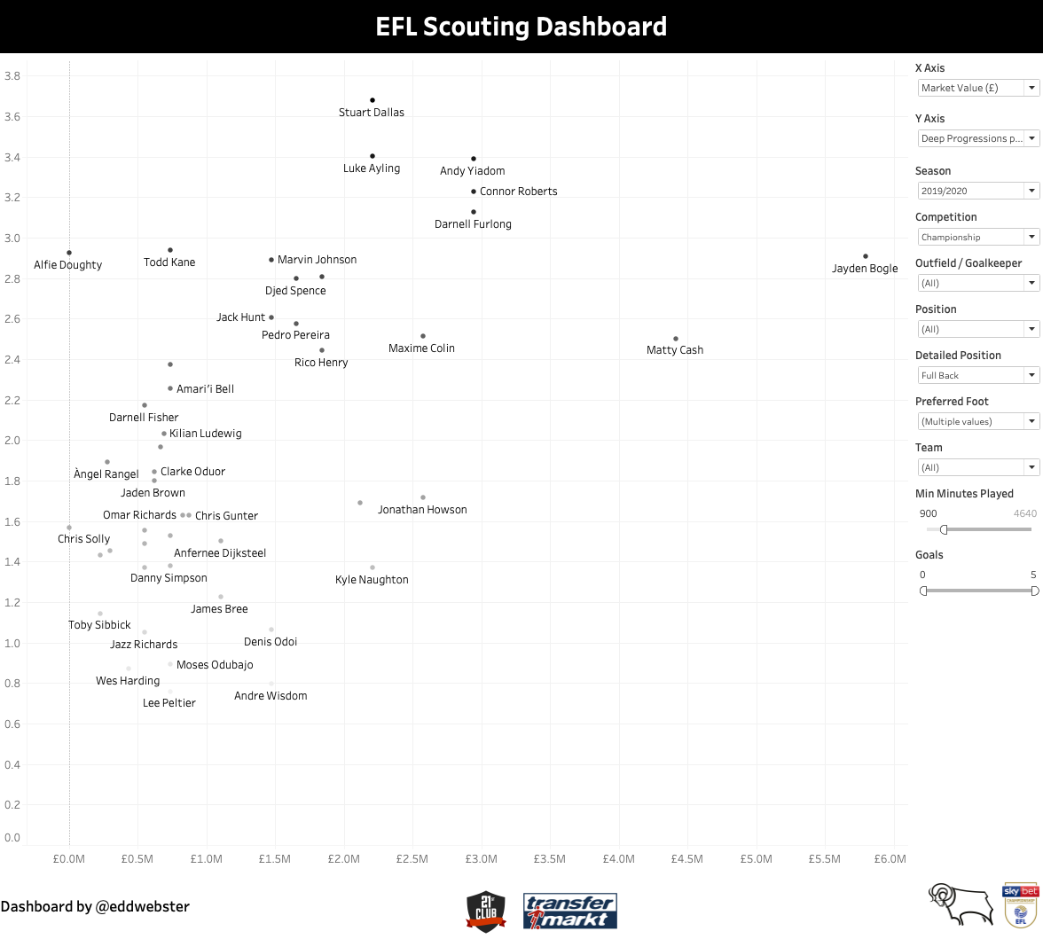
Tool 5: Dynamic Valuation/Value Dashboard
Player surveillance tool that compares real-world performance and estimated market value
Interactive player recruitment dashboard created by fuzzy matching two independent datasets - player performance data from 21st Club and player valuation data from TransferMarkt.
Data can be filtered by:
Season
Competition
Estimated Player Value
Preferred Foot
Age
Minutes Played
Goals Scored
The X and Y Axis are dynamic and can be changed to show difference attributes, such as:
Value
Goals p90 and Assists p90
Derived metrics including Deep Progressions p90 ( as shown in this example)
Metrics that could be used to improve the performance of this dashboard with additional data:
‘Potential Impact’ - derived metric based on professional opinion
Contract expiry information
International status
Career league minutes
Scout reports
Current/expected wages
Player performance data provided by 21st Club and estimated market value data provided by TransferMarkt

Slide 15
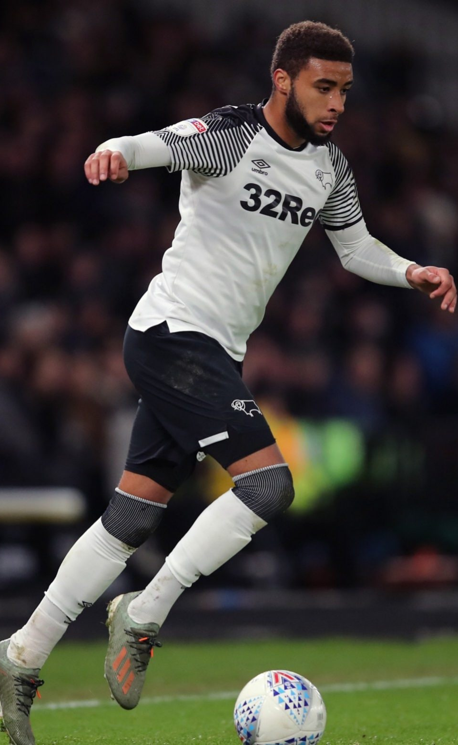
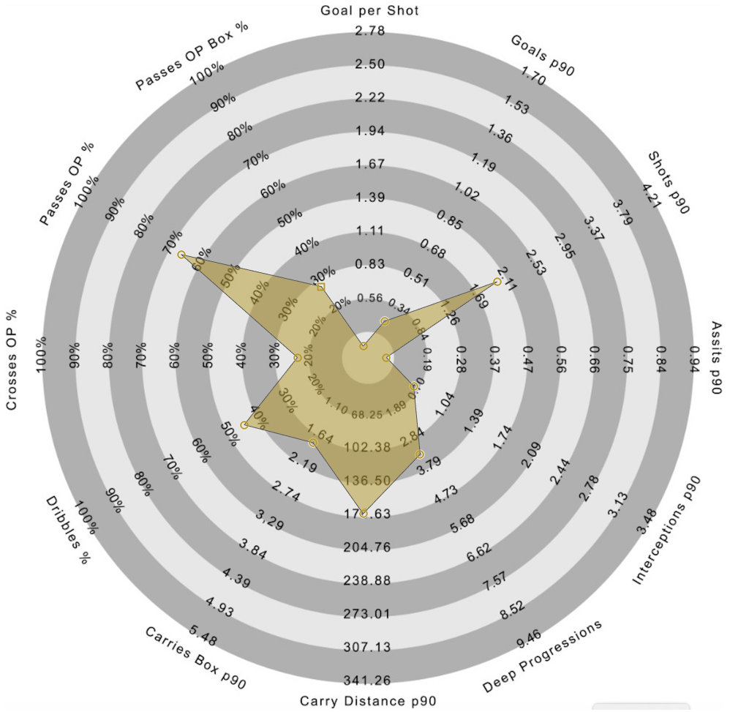
Jayden Bogle
Player profile
DoB: 27/07/2000
Place of birth: Reading
Age: 20
Foot: Right
Height: 1.78m
Nationality: English
Senior International caps (goals): 0 (0)
Main position: Right-Back
Other position(s): Left-Back
Total appearances for Derby County in all competitions: 91
Goals for Derby: 3
Assists for Derby: 17
Estimated market value: £5.67mil
Player bio data and estimated value data from TransferMarkt. Correct as of 16th September 2020.

Slide 16
Full-Back Metric Demographics
Selected metrics to specifically assess full-backs
This simple attacking metrics dashboard shows the key defensive metrics of the players in the Championship 2019/20 season.
These metrics include: tackles p90, interceptions p90, recoveries p90, deep progressions p90, blocks p90, carries p90, passing OP%, dribbles %, launches %, aerial duels %, ground duels %, and crosses OP%.
This data has been filtered to show only the most recent season – 2019/20.
A player highlighted in one table is also highlighted in other tables.
…
In real world scouting, these metric would be agreed between the data analysts, the coaches, and the manager, to ensure that players are asses for the right playing style.
Team performance data provided by 21st Club.

Slide 17
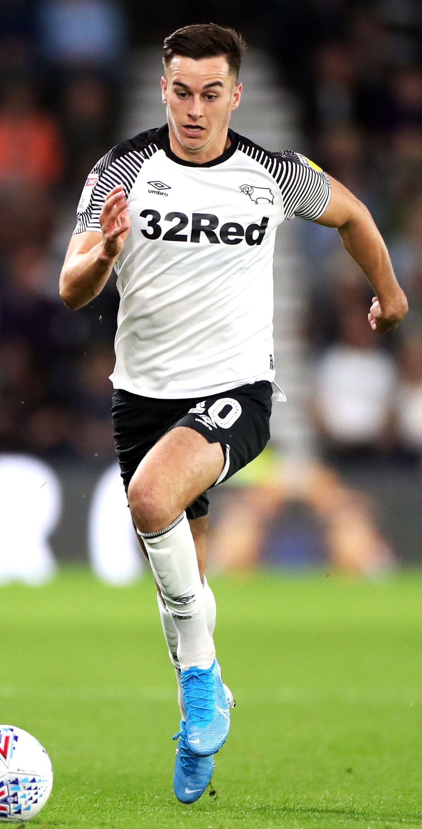
Tom Lawrence
Player profile
DoB: 13/01/1994
Place of birth: Wrexham
Age: 26
Foot: Right
Height: 1.75m
Nationality: Welsh
Senior International caps (goals): 0 (0)
Main position: Left Winger
Other position(s): Second Striker, Right Winger
Total appearances for Derby County in all competitions: 124
Goals for Derby: 23
Assists for Derby: 18
Estimated market value: £4.32mil
Player bio data and estimated value data from TransferMarkt. Correct as of 16th September 2020.

Slide 18
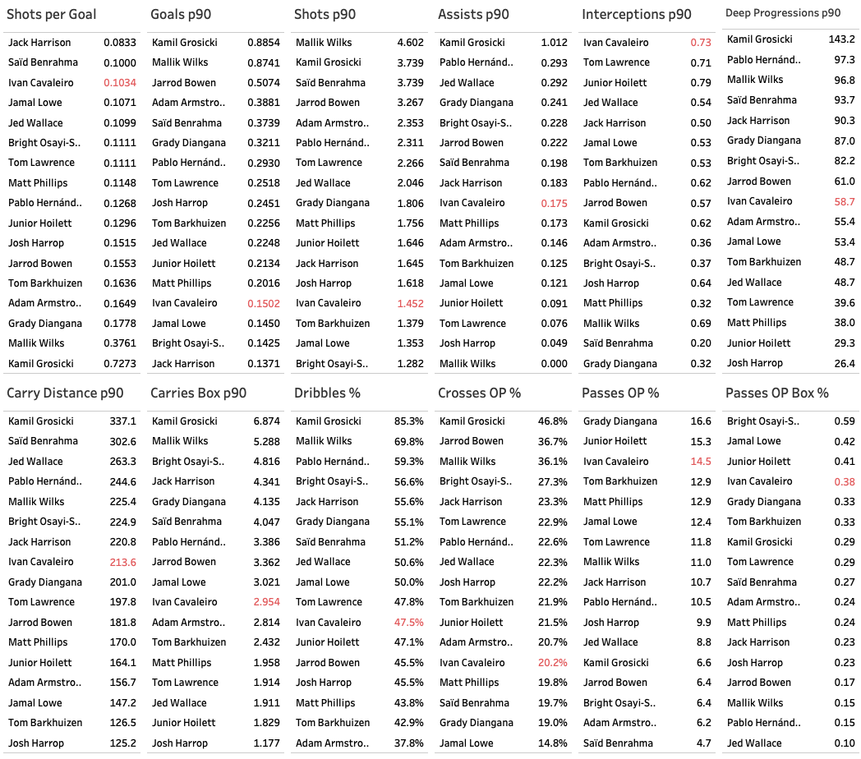
Winger Metric Demographics
Selected metrics to specifically assess wingers
..
Again, in real world scouting, these metric would be agreed between the data analysts, the coaches, and the manager, to ensure that players are asses for the right playing style.
Team performance data provided by 21st Club.

Slide 19
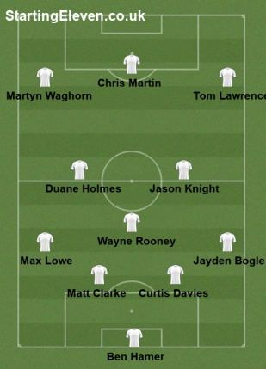
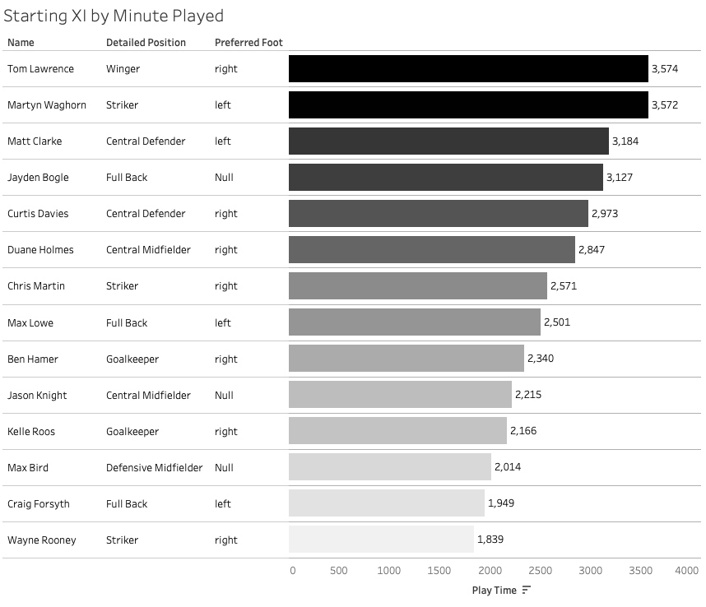
Derby County’s Starting XI
Team Profile - most featured players for the 2019/20 season as per Play Time
Derby’s most common formation was a 4-3-3 with the captain Wayne Rooney playing deep in the midfield.
The players in questions, Tom Lawrence and Jayden, Bogle were both regular starters, featuring 1st (Lawrence) and 4th (Bogle) in terms of minutes respectively during the campaign.
Lawrence was by far Derby’s most used winger, with 3,574 minutes played. The next closest was Florian Jozefzoon with 628 minutes and then Morgan Whittaker with 482 minutes.
Likewise, Bogle was Derby’s most used right-back with 3,127 minutes, ahead of Derby’s alternative right-back Andre Wisdom with 1,583 minutes.
Starting XI graphic produced using StartingEleven.co.uk available: https://startingeleven.co.uk/user-formation/325511

Slide 20
Player Demographics
Simple bar charts the deliver key player information quickly and concisely
Simple bar chart that splits players into their positions – goalkeeper, defender, midfielder, and forward.
The bars show for each player the minutes played, no. appearances, no. starts, and the estimated transfer value.
In this example, we can see the players that had the most minutes on the pitch for Liverpool during their title-winning season.
Dataset is created by fuzzy matching two independent datasets - player performance data from FBref, provided by Statsbomb, and player valuation data from TransferMarkt,
Dataset covers all players in the Big 5 European leagues for the 17/18-20/21 seasons.
Data can be filtered for league, season, club, player nationality, a player’s estimated market value, age, or number of games played by the player.
This is a nice and simple dashboard that can provide a lot of key player information to the analysts and coaches in seconds, all in one location.
Ideas of data that would be good to potentially include:
No. substitute appearances (on and off)
Player height
Dominant foot
Player performance data provided by FBref and estimated market value data provided by TransferMarkt

Slide 21
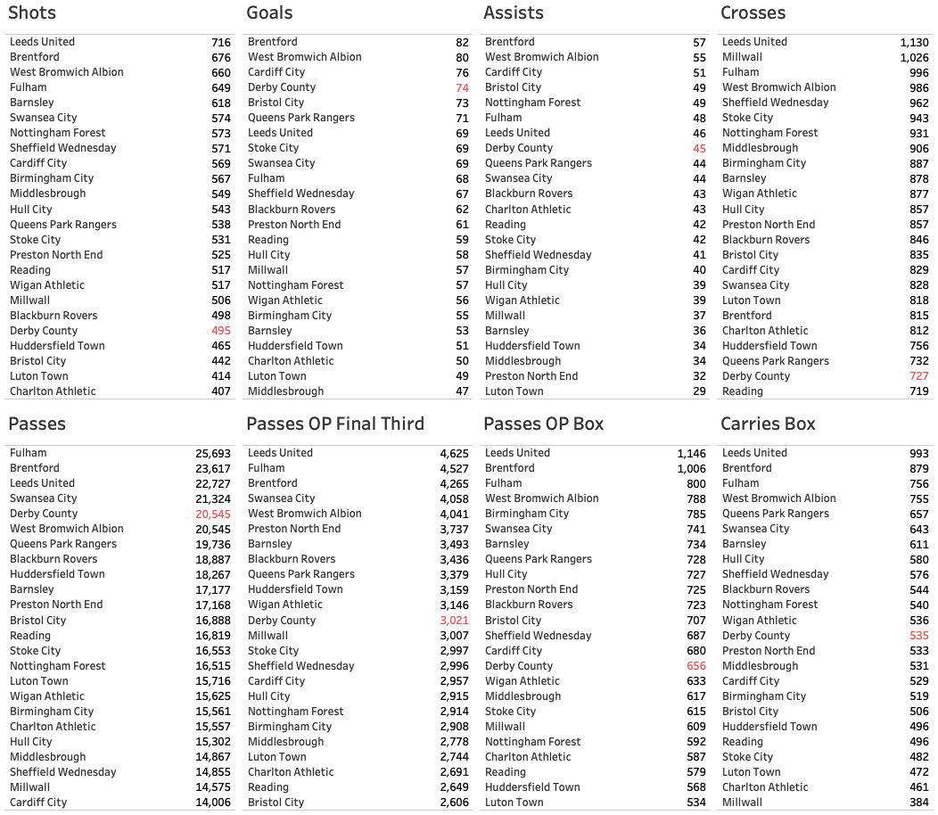
Team Demographics
Overview of teams metrics to get a feel of their playing style
This simple attacking metrics dashboard shows the key attacking metrics of the 24 Championship teams for the 2019/20 season. These metrics includes shots, goals assists, crosses, passes, passes OP (Open Play) final third, passes OP box, and carries into the box.
From the data, we can see
In this example, we can see that for the 19/20 season Manchester City finished top of all attacking metrics bar crosses, however, it was Liverpool that finished as league winners. This suggests that it was Manchester City’s defence that contributed to them not putting up a stronger title challenge during the season.
The data also suggests that Liverpool out-performed their xG, scoring 12 more goals than expected.
Like the Player Demographics dashboard, this is a nice and simple visualisation that can provide a lot of key team information very quickly and in an easily digestible manner.
Team performance data provided by 21st Club.

Slide 22
Player choice 1:
Best performing player in the Championship
for the 2019-2020 season

Slide 23
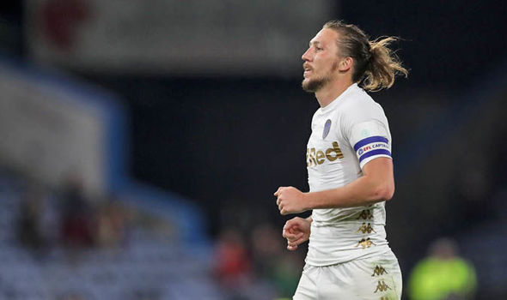
Right-Back Recommendation 1: Luke Ayling
Player profile
DoB: 25/08/1991
Place of birth: London
Age: 29
Foot: Right
Height: 1.83m
Nationality: English
Senior International caps (goals): 0 (0)
Main position: Right-Back
Other position(s): Centre-Back
Total appearances for Leeds in all competitions: 156
Goals for Leeds: 6
Assists for Leeds: 16
Estimated market value: £2.16mil
Player bio data and estimated value data from TransferMarkt. Correct as of 16th September 2020.

Slide 24
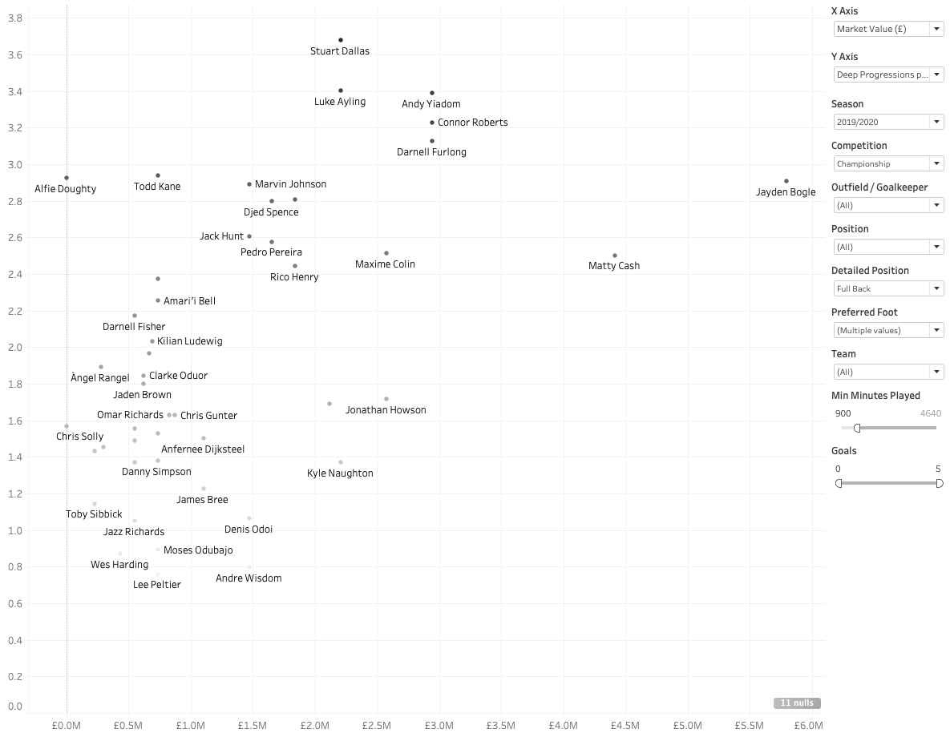
Right-Back Recommendation 1: Luke Ayling
Deep Progressions per 90 Player against estimated market value
Interactive player recruitment dashboard created by fuzzy matching two independent datasets - player performance data from FBref, provided by Statsbomb, and player valuation data from TransferMarkt.
Data can be filtered by:
League
Season
Nationality
Player value
Age
Matched played
The X and Y Axis are dynamic and can be changed to show difference attributes, such as:
Value
Expected Goals (xG) and assists (xA)
Per 90 metrics (e.g. xG per 90)
Non-penalty Expected Goals per Shot (npxG per shot) – for goalkeepers
Metrics that could be used to improve the performance of this dashboard with additional data:
‘Potential Impact’ - derived metric based on professional opinion
Contract expiry information
International status
Dominant foot
Career league minutes
Scout reports
Current/expected wages
Region of highly performing for right-footed full-backs regarding Deep Progressions p90 output
Player performance data provided by 21st Club and estimated market value data provided by TransferMarkt

Slide 25
Right-Back Recommendation 1: Luke Ayling
Player profile
Player Profile
DoB: 25/08/1991
Place of birth: London
Age: 29
Foot: Right
Height: 1.83m
Nationality: English
Senior International caps (goals): 0 (0)
Main position: Right-Back
Other position(s): Centre-Back
Total appearances for Leeds in all competitions: 156
Goals for Leeds: 6
Assists for Leeds: 16
Estimated market value: £2.16mil
Bogle finished the 2019/20 season 4th for Deep Progressions p90 (30.7), a metric in which Ayling finishes 1st (36.0).
Ayling also finished 1st for Interceptions p90 (1.63), Carries p90 (58.15), Dribbles % (79.5%). He finished 2nd for Recoveries p90 (10.65) and in the top 10 for other full-back metrics including Tackles p90, Ground Duels %, and Crosses OP%.
Ayling’s performance have been recognised outside of the stats. For the 2019/20 season, Ayling was promoted to the Premier League with Leeds United, was named in Professional Footballers' Association's 2019–20 EFL Championship Team of the Season and also won the EFL Championship PFA Player of the Year for 2019/20 award after beating off competition from nominees including Ollie Watkins and Aleksandar Mitrovic.
Since Leeds have since been promoted to the Premier League, Ayling is most likely out of price range of most Championship teams, including Derby, and he is unlikely to want to leave the club during a Premier League campaign.
Player bio data and estimated value data from TransferMarkt: https://www.transfermarkt.co.uk/luke-ayling/profil/spieler/67420. Correct as of 16th September 2020.

Slide 26
Winger Recommendation 1:
Player profile
Player Profile
DoB: …
Place of birth: …
Age: …
Foot: …
Height: …
Nationality: …
Senior International caps (goals): …
Main position: …
Other position(s): …
Total appearances for Leeds in all competitions: …
Goals for Leeds: …
Assists for Leeds: …
Estimated market value: …
Player bio data and estimated value data from TransferMarkt: https://www.transfermarkt.co.uk/luke-ayling/profil/spieler/67420. Correct as of 16th September 2020.

Slide 27
Player choice 2:
Best U-23 player in the Championship
for the 2019-2020 season

Slide 28
Right-Back Recommendation 2:
Player profile
Player Profile
DoB: …
Place of birth: …
Age: …
Foot: …
Height: …
Nationality: …
Senior International caps (goals): …
Main position: …
Other position(s): …
Total appearances for Leeds in all competitions: …
Goals for Leeds: …
Assists for Leeds: …
Estimated market value: …
Player bio data and estimated value data from TransferMarkt: https://www.transfermarkt.co.uk/luke-ayling/profil/spieler/67420. Correct as of 16th September 2020.

Slide 29
Winger Recommendation 2:
Player profile
Player Profile
DoB: …
Place of birth: …
Age: …
Foot: …
Height: …
Nationality: …
Senior International caps (goals): …
Main position: …
Other position(s): …
Total appearances for Leeds in all competitions: …
Goals for Leeds: …
Assists for Leeds: …
Estimated market value: …
Player bio data and estimated value data from TransferMarkt: https://www.transfermarkt.co.uk/luke-ayling/profil/spieler/67420. Correct as of 16th September 2020.

Slide 30
Player choice 3:
Best performing player outside the Championship
for the 2019-2020 season

Slide 31
Right-Back Recommendation 3:
Player profile
Player Profile
DoB: …
Place of birth: …
Age: …
Foot: …
Height: …
Nationality: …
Senior International caps (goals): …
Main position: …
Other position(s): …
Total appearances for Leeds in all competitions: …
Goals for Leeds: …
Assists for Leeds: …
Estimated market value: …
Player bio data and estimated value data from TransferMarkt: https://www.transfermarkt.co.uk/luke-ayling/profil/spieler/67420. Correct as of 16th September 2020.

Slide 32
Winger Recommendation 3:
Player profile
Player Profile
DoB: …
Place of birth: …
Age: …
Foot: …
Height: …
Nationality: …
Senior International caps (goals): …
Main position: …
Other position(s): …
Total appearances for Leeds in all competitions: …
Goals for Leeds: …
Assists for Leeds: …
Estimated market value: …
Player bio data and estimated value data from TransferMarkt: https://www.transfermarkt.co.uk/luke-ayling/profil/spieler/67420. Correct as of 16th September 2020.

Slide 33
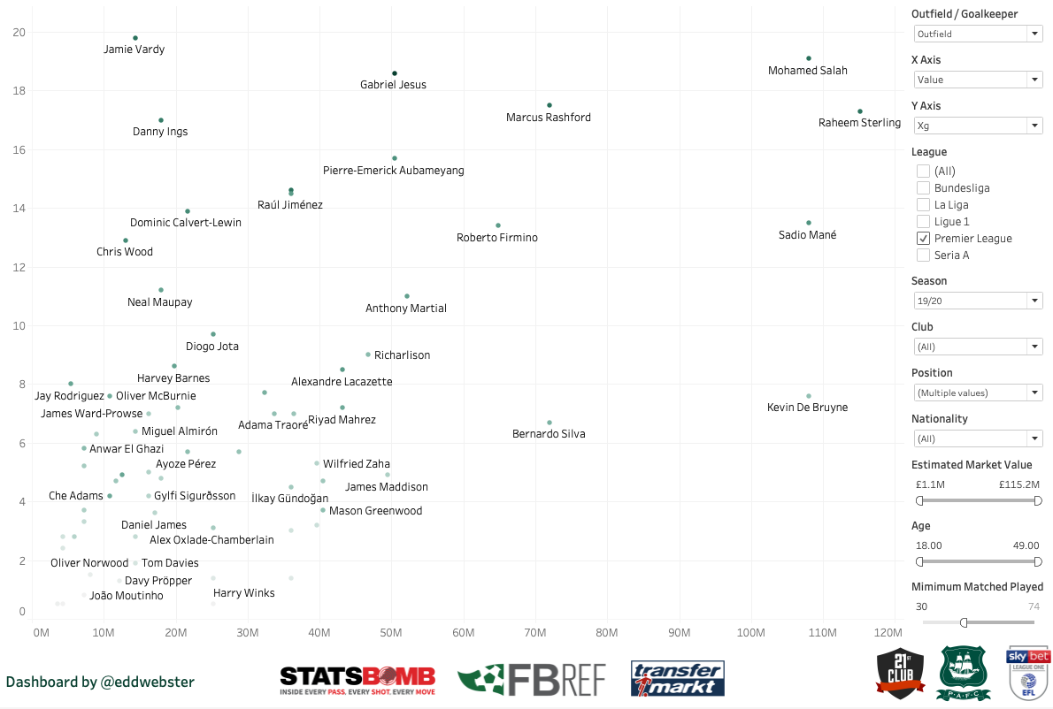
Recruitment - Outfielders
Player surveillance tools, graded by real-world performance and estimated market value
Interactive player recruitment dashboard created by fuzzy matching two independent datasets - player performance data from FBref, provided by Statsbomb, and player valuation data from TransferMarkt.
Data can be filtered by:
League
Season
Nationality
Player value
Age
Matched played
The X and Y Axis are dynamic and can be changed to show difference attributes, such as:
Value
Expected Goals (xG) and assists (xA)
Per 90 metrics (e.g. xG per 90)
Non-penalty Expected Goals per Shot (npxG per shot) – for goalkeepers
Metrics that could be used to improve the performance of this dashboard with additional data:
‘Potential Impact’ - derived metric based on professional opinion
Contract expiry information
International status
Dominant foot
Career league minutes
Scout reports
Current/expected wages
The ideal region for scouting/potential transfers based on numbers alone as these are the lower value players with a high return regarding xG
Player performance data provided by FBref and estimated market value data provided by TransferMarkt

Slide 34
Appendix

Slide 35
Next Steps…
Examples of analysis I plan/wish to conduct with more time and/or data
Principle Component Analysis (PCA) of players similarity. Potentially try and find the metrics most associated to players with a higher TransferMarkt value.
Further improvement of the Knutson radars [link] of player metrics using Expected Goals (xG), Expected Assists (xA), xGBuildup, and Expected Threat (xT) metrics.
Formation analysis – further analyse player that fit into certain playing styles e.g. three-at-the-back formations, 4-3-3, strikers that play in a two, etc.

Slide 36
Requirements of Data Analysis in Football
Analysis produced for football needs to be the following…
1
Simple – deliver clear and concise messages that can be quickly comprehended by busy coaches.
Enable control – data and visualisations need to include filters, tool tips, and actions, that can allow the user (often coaches) to find the insights themselves without the need for programming or dashboard building skills.
Flexible – tools created need to be ready-made so that they can be easily updated and reproduced during a packed, busy season, often with two First Team games a week.
2
3

Slide 37
Complete list of metrics and definitions
Available for reference
Metrics used in the data and their perceived definitions (none provided with the data):
'season’,
'competition_id’,
'competition’,
'player_id’,
'name’,
'team_id’,
'team’,
'age’,
'nationality’,
'height’,
'weight’,
'preferred_foot’,
'position’,
'detailed_position’,
'goals’,
'assists’,
'position_am_perc’,
'position_cb_perc’,
'position_cf_perc’,
'position_cm_perc’,
'position_dm_perc’,
'position_gk_perc’,
'position_lb_perc’,
'position_lw_perc’,
'position_rb_perc’,
'position_rw_perc’,
'play_time’,
'ball_in_play_time’,
'shots’,
'shots_open_play’,
'shots_open_play_box’,
'shots_op_left_foot’,
'shots_op_right_foot’,
'shots_op_head’,
'crosses’,
'crosses_open_play’,
'crosses_op_successful’,
'crosses_op_left’,
'crosses_op_right’,
'passes’,
'passes_open_play’,
'passes_op_successful’,
'passes_op_head’,
'passes_op_head_successful’,
'passes_op_final_third’,
'passes_op_final_third_successful’,
'passes_op_box’,
'passes_op_box_successful’,
'launches’,
'launches_successful’,
'carries’,
'carries_box’,
'carry_distance’,
'dribbles’,
'dribbles_successful’,
'dribbles_box', 'recoveries', 'tackles',
‘interceptions', 'blocks', 'clearances', 'saves', 'aerial_duels_att',
'aerial_duels_att_won’,
'ground_duels_att’,
'ground_duels_att_won’,
'aerial_duels_def’,
'aerial_duels_def_won’,
'ground_duels_def’,
'ground_duels_def_won'

Slide 38

For More Information
If you would like to find out more…
Tableau Public profile: public.tableau.com/profile/edd.webster. See the dashboard titled 'Edd Webster Plymouth Argyle Data Analysis’ for the dashboards featured in this deck.
GitHub:
General: github.com/eddwebster
Football analytics specifically, including all notebooks to scrape, wrangle and engineer the data used in this notebook: github.com/eddwebster/football_analytics
Website: eddwebster.com
LinkedIn: linkedin.com/in/eddwebster
Twitter: @eddwebster
Email: edd.j.webster@gmail.com

Slide 39
References
Player Information:
Jayden Bogle:
Tom Lawrence: https://www.transfermarkt.co.uk/tom-lawrence/profil/spieler/229970
Data Sources:
Aggregated player stats for the top five leagues (Premier League, Ligue 1, Seria A, Bundesliga, and La Liga) for the 17/18, 18/19, 19/20, and current 20/21 season, provided by Fbref: https://fbref.com/en/
Estimated player valuations data from TransferMarkt: https://www.transfermarkt.co.uk/
Shooting data, provided by Understat: https://understat.com/
Event data for the Big 5 European leagues (Premier League, Ligue 1, Seria A, Bundesliga, and La Liga) for the 17/18 season only, provided by Wyscout: https://figshare.com/collections/Soccer_match_event_dataset/4415000/2. This data is taken from the following academic paper: Pappalardo, L., Cintia, P., Rossi, A. et al. A public data set of spatio-temporal match events in soccer competitions. Scientific Data 6, 236 (2019) doi:10.1038/s41597-019-0247-7, https://www.nature.com/articles/s41597-019-0247-7
Key Python libraries used:
pandas
Matplotlib
Beautiful Soup
Record Linkage

